Slide 1
Securing a Microsoft ASP.NET Web Application

Slide 2
Authentication vs. Authorization
Authentication
obtaining identification credentials such as a name and a password from a user
validating those credentials against some authority such as a database.
Authorization
determines if that identity has access to a specified resource
Assign authorization by user name or by role

Slide 3
What Are the ASP.NET Authentication Methods?
Windows-based authentication
Forms-based authentication
Microsoft Passport authentication

Slide 4
Windows-Based Authentication
Relies on the Windows operating system and IIS to authenticate the user
User requests a secure Web page from the Web application, and the request then goes through IIS
After credentials are verified by IIS, the secure Web page is returned

Slide 5
Forms-Based Authentication
Unauthenticated requests are redirected to an HTML form
User provides credentials and submits the HTML form
After credentials are verified, an authentication cookie is issued

Slide 6
Comparing the ASP.NET Authentication Methods
Method | Advantages | Disadvantages
Windows-based Authentication | Uses existing Windows infrastructure Controls access to sensitive information | Not appropriate for most internet applications Based on cookies
Forms-based Authentication | Good for Internet applications Supports all client types | Based on cookies

Slide 7
What Are the IIS Authentication Mechanisms?
Mechanisms | Security Level | Mechanisms
Anonymous | None | No authentication occurs
Basic | Low (Medium with SSL) | Client sends username and password as clear text Can be encrypted by using SSL Part of the HTTP specification and supported by most browsers
Digest | Medium | Sends information as encoded hash Requires Internet Explorer 5, 6, or 7 Requires Active Directory
Integrated Windows | High | Uses either NTLM or Kerberos Generally good for intranets, not internet Does not work through most firewalls

Slide 8
What Is Secure Sockets Layer?
SSL is a protocol that transmits data securely across a network. SSL secures data by using:
Data encryption:
Ensures that the data sent is read only by a secure target server
Server authentication:
Ensures that data is sent to the correct server
Uses the server and client certificates
Data integrity:
Protects the integrity of the data
Includes a message authentication code that detects whether a message is altered
SSL uses Hypertext Transfer Protocol Secure to retrieve an ASP.NET Web page

Slide 9
Windows-Based Authentication
Use Windows-based authentication to secure Web applications when you know which users access your Web site

Slide 10
Enabling Windows-Based Authentication
Configure IIS to use one or more of the following authentication mechanism:
Basic, Digest, Integrated Windows security
Set Windows-based authentication in Web.config
<system.web>
<authentication mode="Windows" />
</system.web>
Set up authorization in Web.config
<authorization>
<deny users="thsun-PC\thsun" />
</authorization>
When users access the Web Form, IIS requests login information

Slide 11
Restrict certain types of users,
<authorization>
<deny users = "?" />
<allow roles = ".\SalesAdministrator,.\SalesStaff" />
<deny users = ".\matthew" />
</authorization>

Slide 12
Examine a user’s group membership programmatically
Protected Sub Page_Load(sender As Object, _
e As System.EventArgs) Handles Me.Load
If User.IsInRole("MyDomainName\SalesAdministrators") Then
' Do nothing; the page should be accessed as normal because
' the user has administrator privileges.
Else
' Don't allow this page. Instead, redirect to the home page.
Response.Redirect("Default.aspx")
End If
End Sub

Slide 13
Examine a user’s group membership programmatically
To check whether a user is a member of one of the built-in groups
If User.IsInRole("BUILTIN\Administrators") Then
' (Code goes here.)
End If

Slide 14
Reading User Information
After authentication, the Web server can read the user Identity
userLabel.Text = User.Identity.Name
userTypeLabel.Text = User.Identity.AuthenticationType
userAuthenticatedLabel.Text = User.Identity.IsAuthenticated
Read the user identity using User.Identity.Name
Use User.Identity.AuthenticationType to identify the IIS authentication mechanism
Test if the user is authenticated by using User.Identity.IsAuthenticated.
User.Identity is an object of the WindowsIdentity class and does not require a reference or import statement.

Slide 15
Forms-Based Authentication
Overview of Forms-Based Authentication
Enabling Forms-Based Authentication
Creating a Logon Page

Slide 16
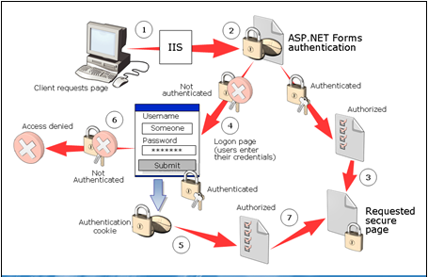
Overview of Forms-Based Authentication

Slide 17
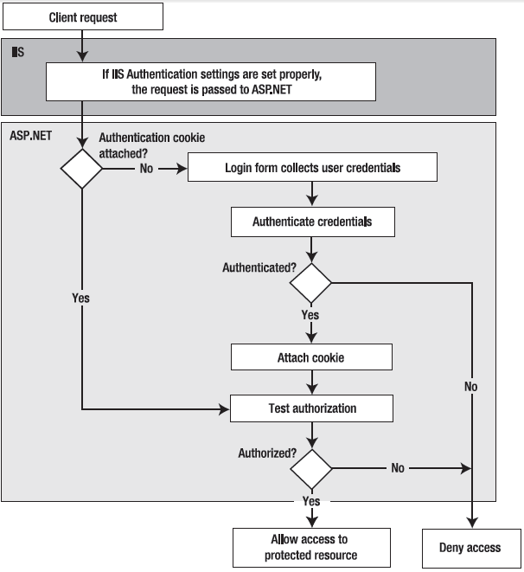
The forms authentication process

Slide 18
Events of Forms-Based Authentication
A client generates a request for a protected .aspx page.
IIS receives the request and passes it to ASP.NET.
ASP.NET checks to see if a valid authentication cookie is attached to the request. If it is then the request is tested for authorization by comparing the credentials that are contained in the request’s authorization cookie with the authorization settings that are in the web.config file. If the user is authorized, access to the requested secure page is granted.
If there is no cookie attached to the request, ASP.NET redirects the request to a logon page (the path of which resides in the application’s configuration file).
The application code on the logon page checks the credentials to confirm their authenticity. If authenticated, the code attaches a cookie that contains the credentials of the request.
If authentication fails, the request is returned with an "Access Denied" message.
If the user is authenticated, ASP.NET checks authorization (as in Step 3) and can then either allow access to the originally requested secure page or redirect the request to another page, depending on the design of the application.

Slide 19
Why Use Forms Authentication?
Full control over the authentication code
Full control over the appearance of the login form
It works with any browser
It allows you to decide how to store user information.

Slide 20
Why Would You Not Use Forms Authentication?
Need to create the user interface for users to log in
Need to maintain a catalog with user credentials
Need to take additional precautions against the interception of network traffic

Slide 21
Enabling Forms-Based Authentication
Configure IIS to use Anonymous authentication
Set Forms-based authentication in Web.config
<system.web>
<authentication mode="Forms">
<forms name=".ASPXAUTH" loginUrl="login.aspx" />
</authentication>
</system.web>
Set up authorization
Build a logon Web Form

Slide 22
The complete set of options for the forms tag:
<authentication mode="Forms">
<!-- Detailed configuration options -->
<forms name="MyCookieName"
loginUrl="DbLogin.aspx"
timeout="20"
slidingExpiration="true"
cookieless="AutoDetect"
protection="All"
requireSSL="false"
enableCrossAppRedirects="false"
defaultUrl="MyDefault.aspx“
path="/" />
</authentication>

Slide 23
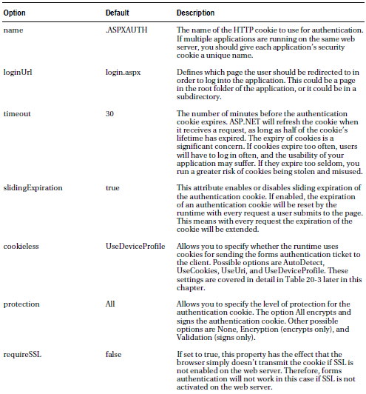
The Forms Authentication Options

Slide 24
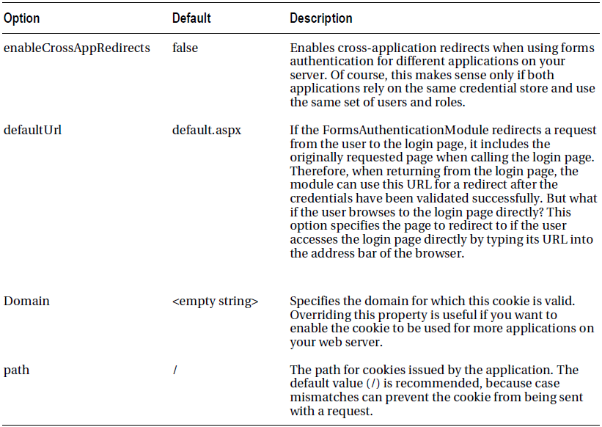
The Forms Authentication Options

Slide 25
Authorization Rules
<configuration>
...
<system.web>
...
<authentication mode = "Forms">
<forms loginUrl = "~/Login.aspx" />
</authentication>
<authorization>
<allow users = "*" />
</authorization>
</system.web>
</configuration>
The asterisk (*) is a wildcard character that explicitly permits all users to use the application—even those who haven’t been authenticated.

Slide 26
Denying Access to Anonymous Users
<configuration>
<system.web>
<!-- Other settings omitted. -->
<authorization>
<deny users="?" />
</authorization>
</system.web>
</configuration>
The question mark (?) is a wildcard character that matches all anonymous users

Slide 27
What happens if you add more than one rule to the authorization section ?
Example,
<authorization>
<allow users = "*" />
<deny users = "?" />
</authorization>
ASP.NET scans the list from top to bottom and then continues with the settings in any .config file inherited from a parent directory, ending with the settings in the base machine.config file.
As soon as it finds an applicable rule, it stops its search.
These rules will allow all users, including anonymous users

Slide 28
How about this?
<authorization>
<deny users = "?" />
<allow users = "*" />
</authorization>
These rules will deny anonymous users (by matching the first rule) and allow all other users (by matching the second rule).

Slide 29
Controlling Access to Specific Files
Add < location > tags to web.config file
The location tags sit outside the main < system.web > tag and are nested directly in the base < configuration > tag,
<configuration>
...
<system.web>
...
<authentication mode = "Forms">
<forms loginUrl = "~/Login.aspx" />
</authentication>
<authorization>
<allow users = "*" />
</authorization>
</system.web>
<location path = "SecuredPage.aspx">
<system.web>

Slide 30
Controlling Access to Specific Files
<authorization>
<deny users = "?" />
</authorization>
</system.web>
</location>
<location path = "AnotherSecuredPage.aspx">
<system.web>
<authorization>
<deny users = "?" />
</authorization>
</system.web>
</location>
</configuration>

Slide 31
Controlling Access for Specific Users
<authorization>
<deny users = "?" />
<deny users = "matthew,sarah" />
<deny users = "john" />
<allow users = "*" />
</authorization>
All anonymous users, matthew, sarah and john are denied access but all other successfully logged in users will be granted access.

Slide 32
Rules that explicitly allow two users
<authorization>
<deny users = "?" />
<allow users = "matthew,sarah" />
<deny users = "*" />
</authorization>

Slide 33
Using WAT to set the rules

Slide 34
Adding an authorization rule

Slide 35
Manage Access Rules link
Ordering authorization rules

Slide 36
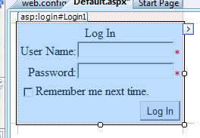
Creating a Logon Page
ASP.NET login controls
Creating a logon page
Reading credentials from cookies

Slide 37
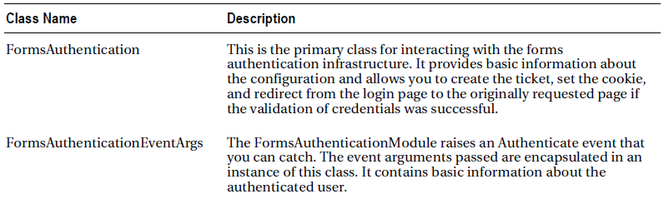
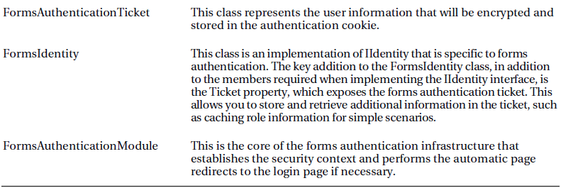
The Forms Authentication Framework Classes

Slide 38
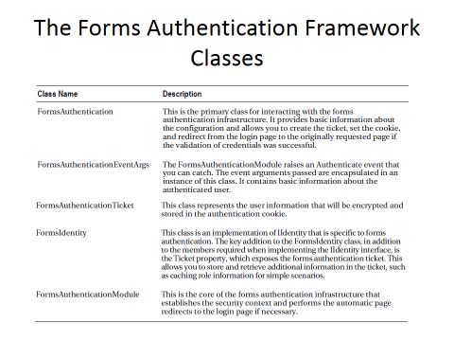
Members of the Forms Authentication Class

Slide 39
Code for validating the credentials against the values entered by the user
Protected Sub LoginAction_Click(ByVal sender As Object, ByVal e As System.EventArgs
) Handles LoginAction.Click
Page.Validate()
If Not Page.IsValid Then
Return
End If
If PasswordText.Text = "secret" Then
' Create the ticket, add the cookie to the response
' and redirect to the originally requested page
FormsAuthentication.RedirectFromLoginPage(UsernameText.Text, False)
Else
' Username and password are not correct
LegendStatus.Text = "Invalid username or password!"
End If
End Sub

Slide 40
FormsAuthentication.RedirectFromLoginPage
This method performs several tasks at once:
It creates an authentication ticket for the user.
It encrypts the information from the authentication ticket.
It creates a cookie to persist the encrypted ticket information.
It adds the cookie to the HTTP response, sending it to the client.
It redirects the user to the originally requested page (which is contained in the query string parameter of the login page request’s URL).

Slide 41
Retrieving the User’s Identity
Can retrieve the identity through the built-in User property
Protected Sub Page_Load(sender As Object, _
e As System.EventArgs) Handles Me.Load
lblMessage.Text = "You have reached the secured page, "
lblMessage.Text & = User.Identity.Name + "."
End Sub

Slide 42
The User object
The Identity property lets you retrieve the name of the logged-in user and the type of authentication that was used.
The IsInRole() method lets you determine whether a user is a member of a given role (and thus should be given certain privileges). You’ll use IsInRole() later in this chapter.

Slide 43
Logging Out
Create a logout button and add the following code
Protected Sub SignOutAction_Click(
ByVal sender As Object, ByVal e As System.EventArgs
) Handles SignOutAction.Click
FormsAuthentication.SignOut()
FormsAuthentication.RedirectToLoginPage()
End Sub

